Slide 1


Slide 2
How Technology is changing the world of Finance; Repositioning ourselves as finance professionals to be future fit

Slide 3
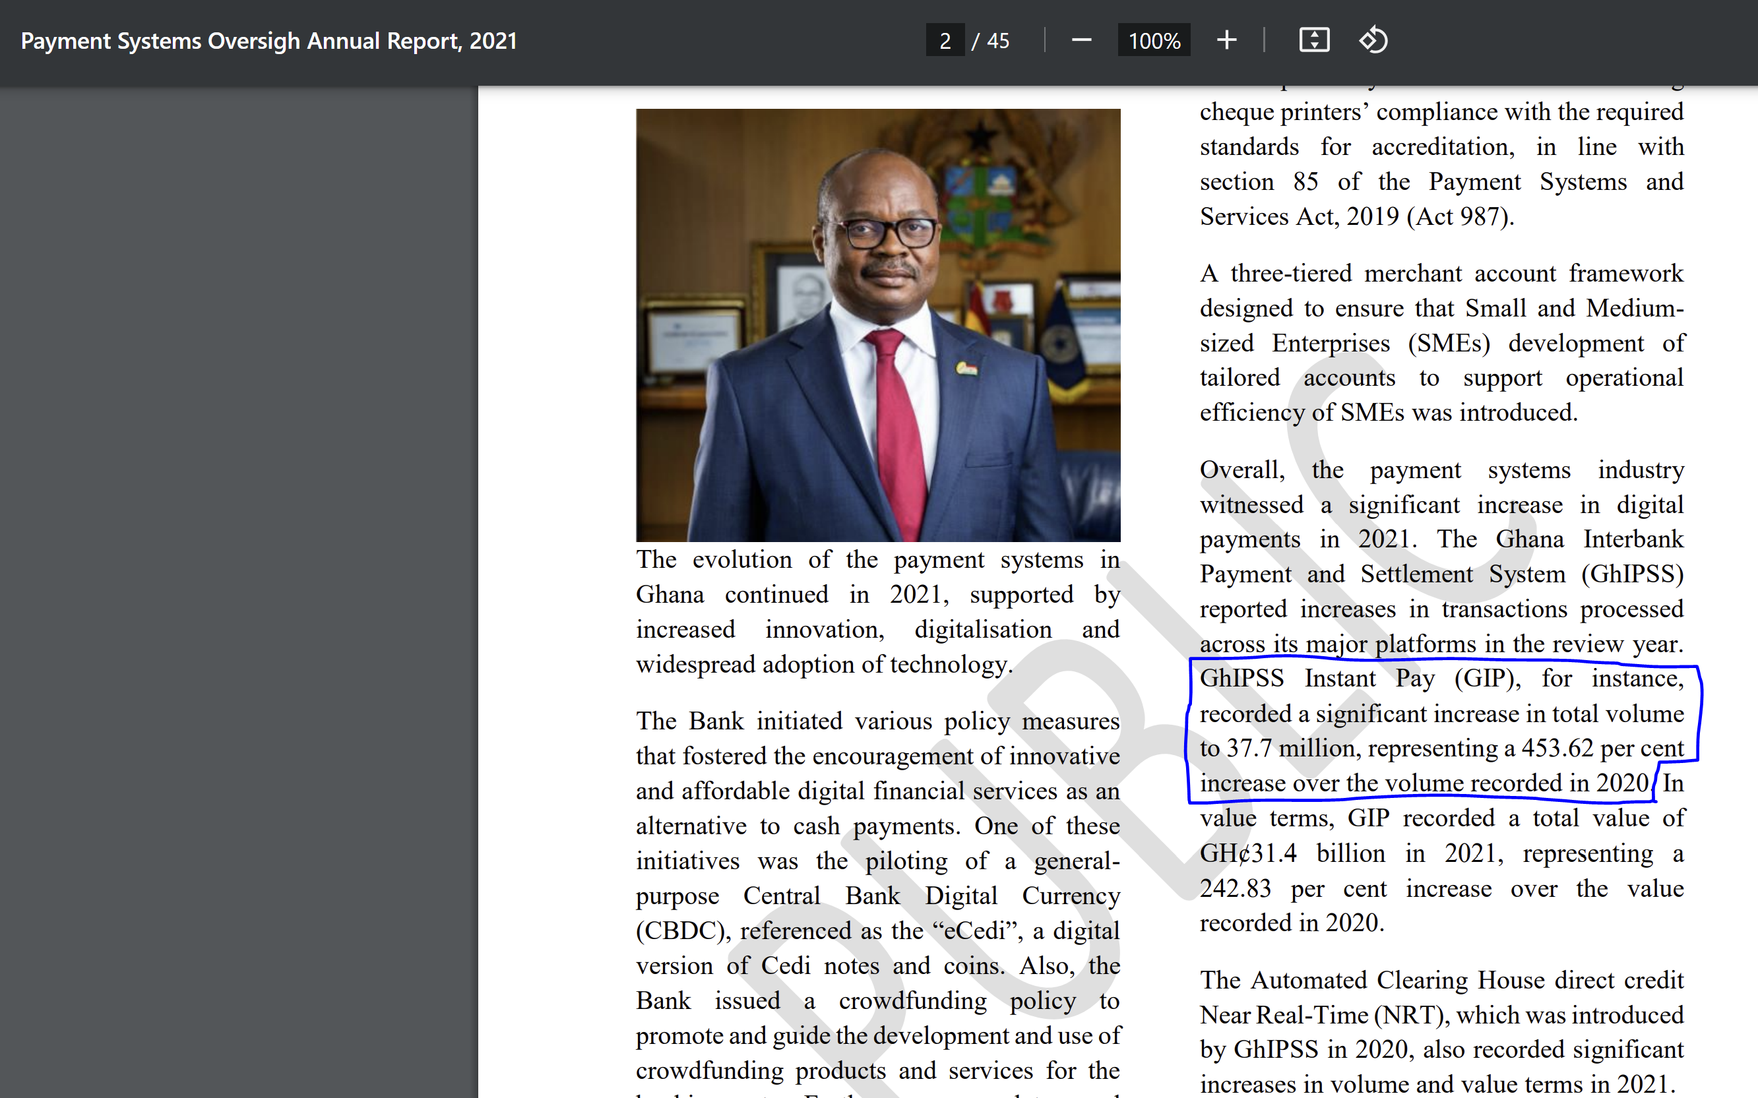
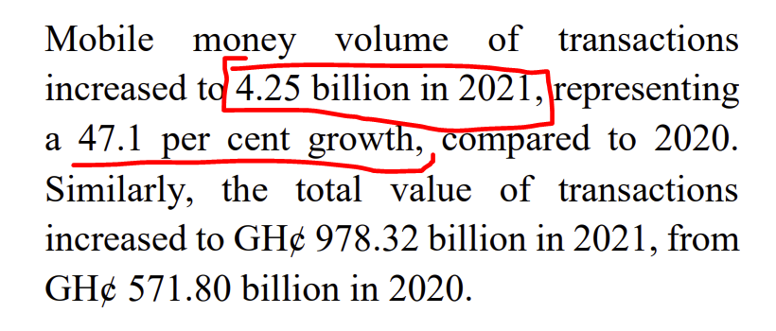
In the past 50 years
Online Banking and Financial Services
Internet and web-based technologies allowed for the development of online banking and financial services. Customers can now access their accounts, transfer funds, pay bills, and invest online, reducing the need for physical bank branches and paper-based transactions
Electronic Trading Platforms
These platforms replaced traditional floor trading with computerized systems, enabling faster and more efficient trading. High-frequency trading (HFT) algorithms now execute millions of trades in milliseconds, impacting market dynamics and liquidity.

Slide 4
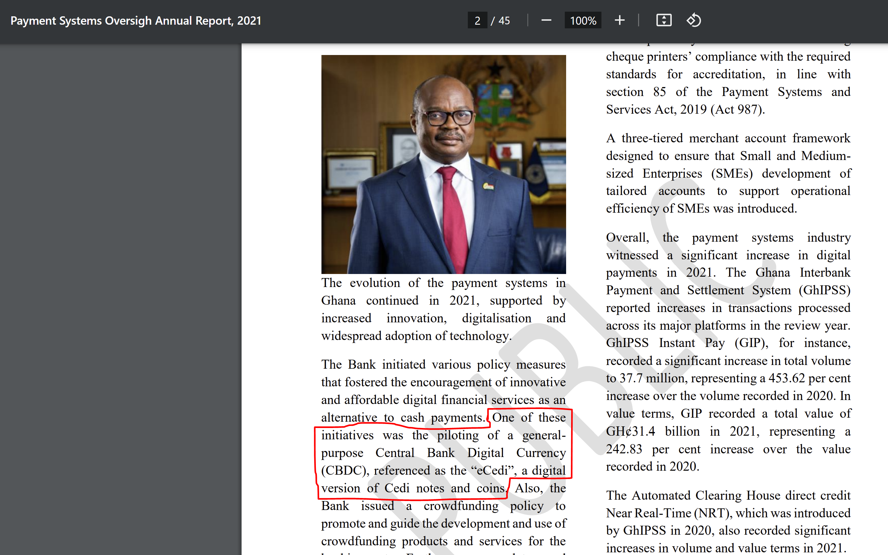
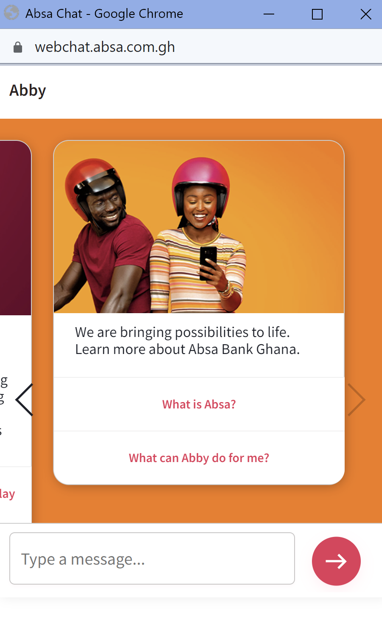
CURRENT TRENDS
Artificial Intelligence (AI) and Machine Learning (ML)
AI and ML are being increasingly integrated into various aspects of finance such as algorithmic trading, fraud detection, risk assessment, and customer service. AI-powered chatbots and robo-advisors are becoming more prevalent in providing personalized financial advice and services.
Digital Currencies & Central Bank Digital Currencies
The adoption of digital currencies, including cryptocurrencies like Bitcoin, has continued to grow. Additionally, several central banks have been exploring the development of their own digital currencies (CBDCs). These digital currencies have the potential to revolutionize the way transactions are conducted, reducing costs and increasing financial inclusion.

Slide 5
How will THE finance profession look like in the COMING decades
Technology-Driven Transformation
Ethical Finance and Globalization
The finance profession will undergo a profound transformation driven by technology. This encompasses automation, artificial intelligence, data analytics, and the integration of digital currencies. Finance professionals will increasingly rely on technology to automate routine tasks, analyze data for insights, and manage digital assets. This transformation will enhance efficiency and productivity while demanding new skills related to technology and data management.
Finance professionals will operate in an environment where ethical considerations and globalization play a central role. Sustainability, responsible finance, and the incorporation of ESG factors will be integral to decision-making. Simultaneously, the finance profession will be more globally connected, necessitating an understanding of international markets, regulations, and cross-border collaboration. Ethical finance and global perspectives will guide financial strategies and practices.

Slide 6
As a student, how do you position yourself to be future fit.
Education & skills development
Practical experience & networking
Pursue advanced degrees or certifications.
CFA, ACCA, CA, CIB, CPA, CIMA, FPAG etc.
Develop technical and soft skills essential in finance.
Excel, SQL, Python, Tableau, Power BI, ChatGPT/Prompt Engineering (Financial Analysis, Data Analysis, Financial Modelling, Risk Management, Investment Analysis, Budgeting & Forecasting, Taxation, Reporting & Compliance).
Obtain knowledge and hands-on training on globally used core financial systems such as SAP, Sage, Oracle, and NetSuite.
Communication, Negotiation, Collaboration
Stay updated with industry knowledge and trends through continuous learning.
Investopedia, Finance Blogs/Vlogs, ChatGPT, TikTok ☺
Gain hands-on experience through internships and campus involvement.
Banks & Other Fis, FinTech Start-Ups etc.
Build a professional network by attending industry events and using online platforms like LinkedIn.
Seek mentorship and guidance from experienced professionals

Slide 7
As a student, how do you position yourself to be future fit.
Career Preparation and Adaptability
Tailor your resume and cover letter for finance roles.
Prepare for interviews by practicing common finance questions.
Stay informed about industry developments and be open to various finance career paths to remain adaptable and open-minded.
Get a Mentor to steer you through the convolutions.
Attract a Sponsor!

Slide 8
The truth is that most people never start because they never want to be seen starting from the bottom. Don’t be most people.
COLONEL HARLAND SANDERS – FOUNDER OF KFC

